Slide 2
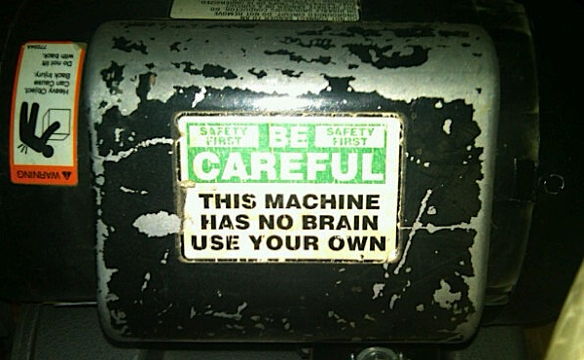
Notes:
In the problem solving business.
Don't know how our frameworks are implemented
- therefore we don't know when to go off the reservation
- if you write code and complexly as you can...
- sometimes the 'magic' behind the scenes makes me uncomfortable
Machine Does not have a mind of it's own
- each application has its own personality
- solutions that work in one place, might not work in another
- know your data
- know your users

Slide 3
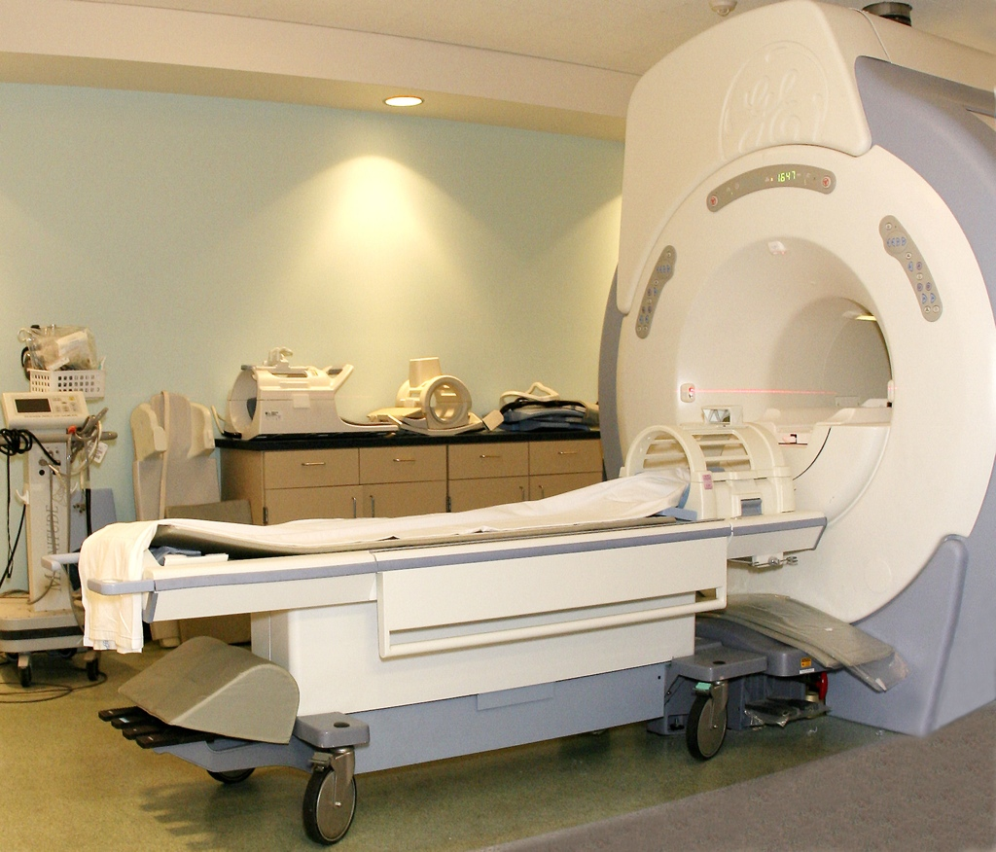

Slide 4


Slide 5
Know what you are implementing

Slide 6
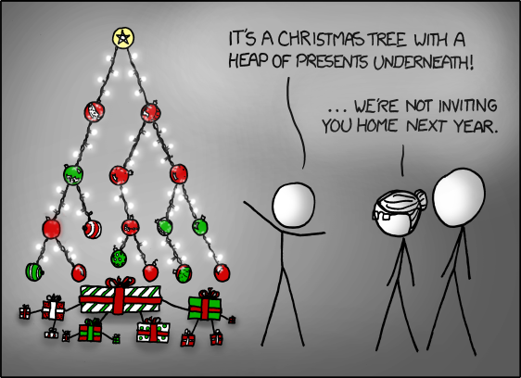
Notes:
SafeAuto Print Tool Queue example
- need to understand our data structures
- List vs. Dictionary, Queue vs. Stack, Tree vs. Heap

Slide 7
Simple Example

Slide 8
Know how to evaluate solutions
Notes:
It’s about finding the right solution for your customer

Slide 9
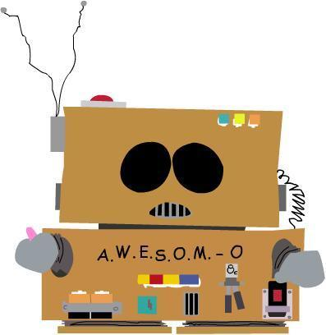
Big O Notation

Slide 10
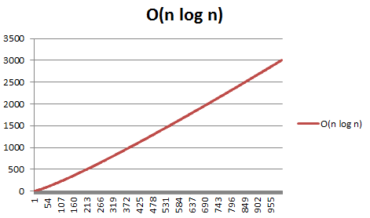
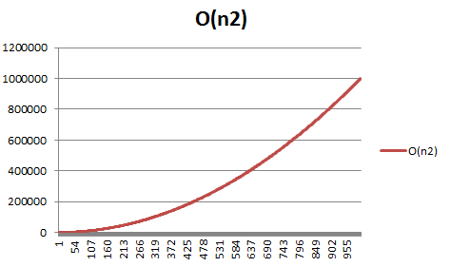
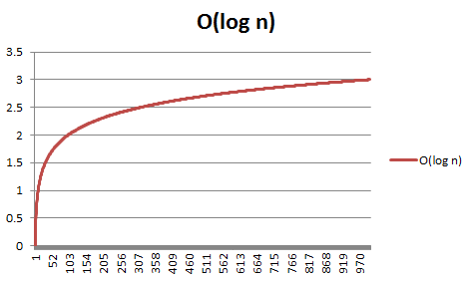
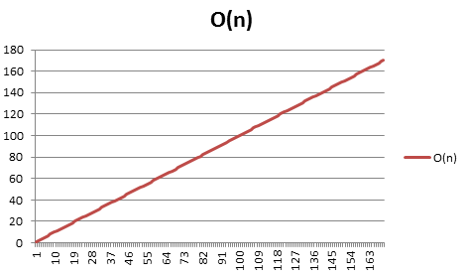

Slide 11
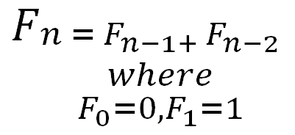

Slide 12
Iterative Methods

Slide 13
O(1)

Slide 14
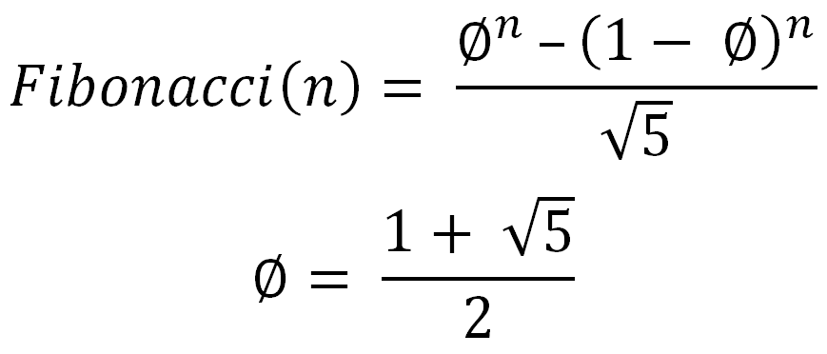
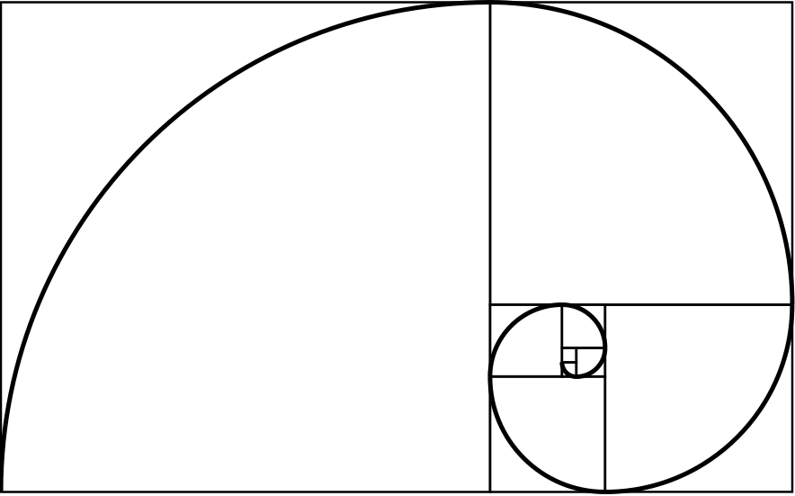

Slide 15
Accuracy

Slide 16
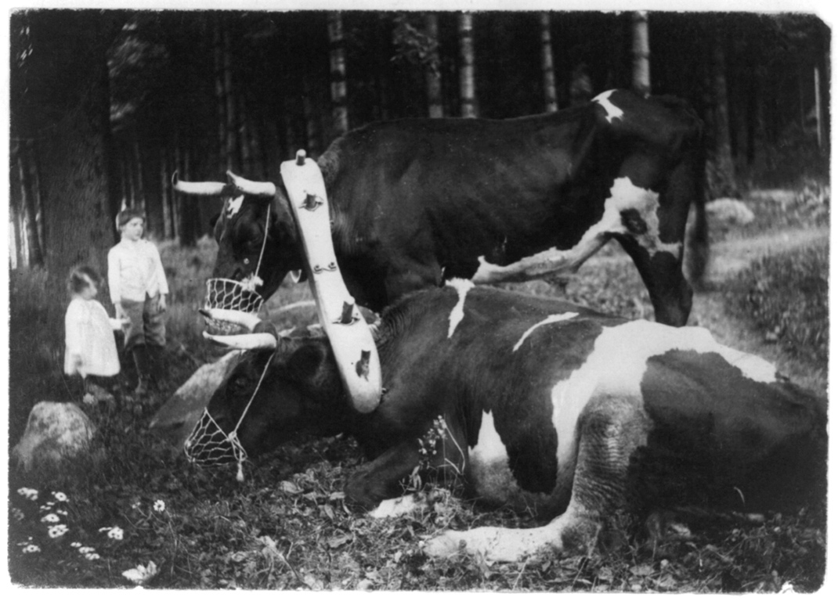

Slide 17
Fibonacci (with a proof) - www.maths.surrey.ac.uk/hosted-sites/R.Knott/Fibonacci/fibFormula.html
Project Euler - www.projecteuler.net
Algorithms in a Nutshell, George T. Heineman, Gary Pollice, Stanley Selkow

Slide 18

Shawn Wallace
Source: https://github.com/shawnewallace/TheAlgorithmsStillCount
shawn@wshawn.com
Twitter: ShawnWallace
Blog: blog.shawnewallace.com
Shirt size: XXL
Shoe Size: 11.5

